Slide 1
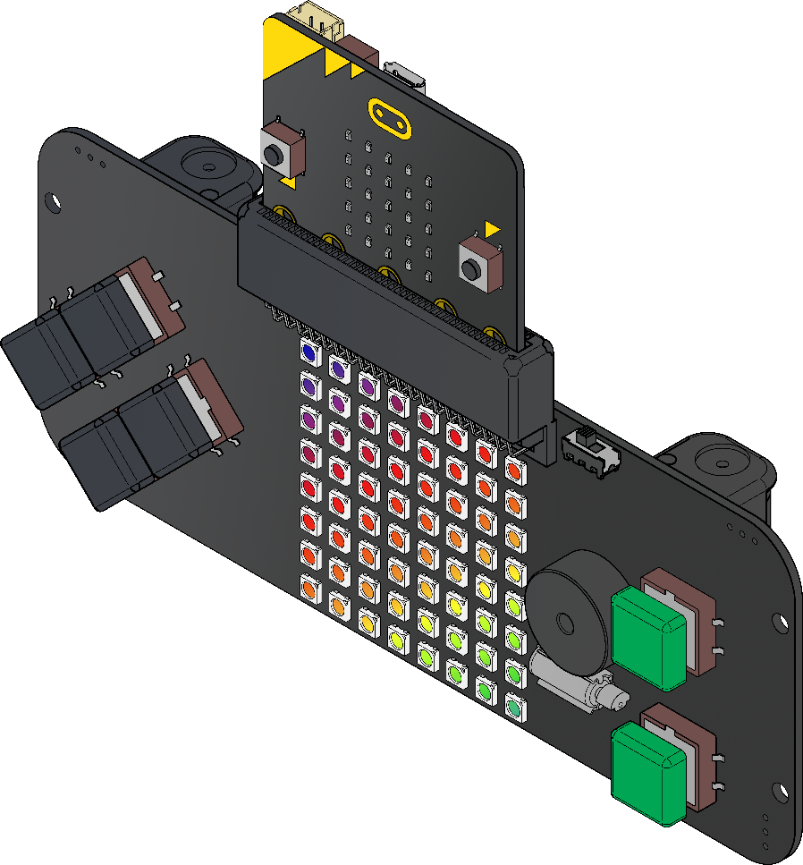
Game Controller
Lesson Five

Slide 2
Old Algorithm
Set CurrentPosition to 0
Turn the CurrentPosition light red
Set score to 0
Display the score on the micro:bit
Set Ball to 0
Turn the Ball light blue
Forever:
When the red light reaches the Ball
Change the score by 1
Display the score on the micro:bit
Set Ball to a random number between 1 and 64
Turn the Ball light blue
Show the light

Slide 3
New Algorithm
Set CurrentPosition to 0
Set CurrentPositionX to 0
Set CurrentPositionY to 0
Turn the CurrentPosition light red
Turn the CurrentPositionX CurrentPositionY light red
Set score to 0
Display the score on the micro:bit
Set Ball to 0
Turn the Ball light blue
Set BallX to 1
Set BallY to 7
Turn the BallX BallY light blue
Forever:
When the red light reaches the Ball
IF the CurrentPositionX = BallX AND CurrentPositionY = BallY THEN
Change the score by 1
Display the score on the micro:bit
Set Ball to a random number between 1 and 64
Set BallX to a random number between 0 and 7
Set BallY to a random number between 0 and 7
Turn the Ball light blue
Turn the BallX BallY light blue
Show the lights
END IF
← On start

Slide 4
AND Truth Table
0 | 0
0 | 1
1 | 0
1 | 1
0 AND 0 is 0
0
0
0 AND 1 is 0
0
1 AND 0 is 0
1
1 AND 1 is 1

Slide 5
OR Truth Table
0 | 0
0 | 1
1 | 0
1 | 1
0 OR 0 is 0
0
1
0 OR 1 is 1
1
1 OR 0 is 1
1
1 OR 1 is 1

