Slide 1
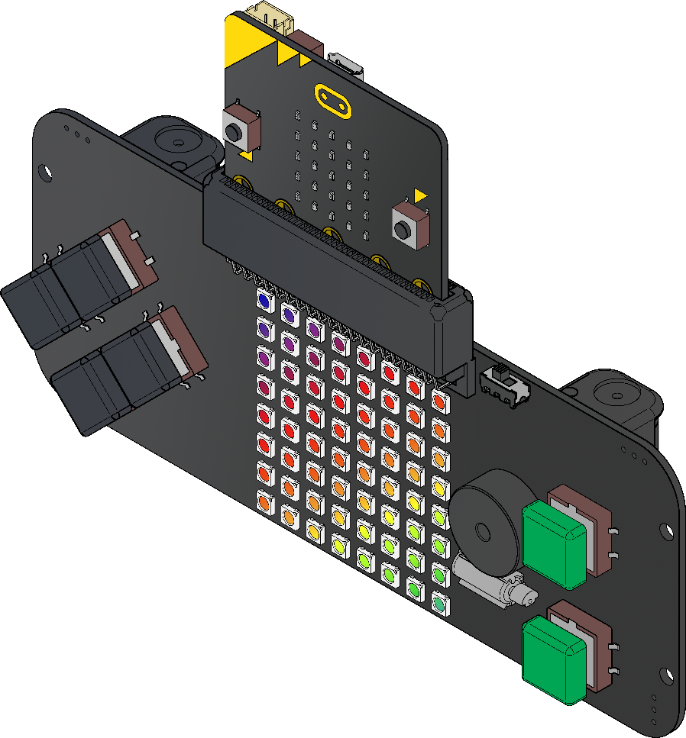
Game Controller
Lesson Two

Slide 2
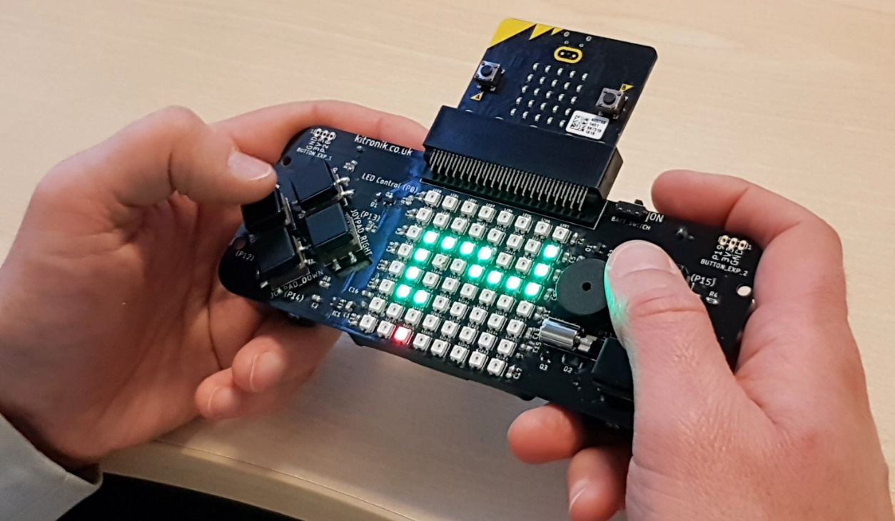
:GAME ZIP 64
4 x buttons
micro:bit
2 x buttons
Buzzer
64 RGB lights
Vibrating motor

Slide 3
Buttons
Button | How it’s connected
Joypad Up | P8
Joypad Down
Joypad Left
Joypad Right
Fire SW 1
Fire SW 2

Slide 4
Buttons

Slide 5
Algorithm
When I press Fire SW 1:
Make all the lights go blue.

Slide 6
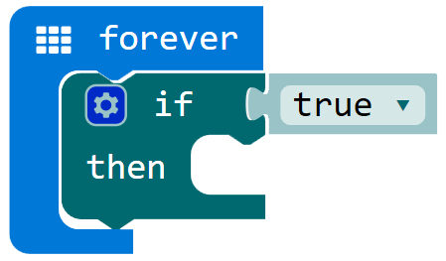
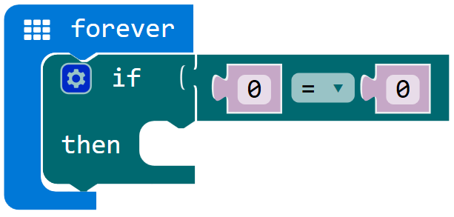
Main Lesson

Slide 7
Input Challenges
When I press the Fire SW 1
Clear the matrix
Show a smiley face on the micro:bit
When I press the Fire SW 2
Clear the micro:bit
Show your character from last week
When I press Up
Clear the matrix
Show an Up arrow on the micro:bit

Slide 8
The Controller
Button | How it’s connected
Joypad Up | P8
Joypad Down | P14
Joypad Left | P12
Joypad Right | P13
Fire SW 1 | P15
Fire SW 2 | P16
Buzzer | P2
Motor | P1

Slide 9
Buzzer
The buzzer is a digital output.
To hear the buzzer we must turn it on and off continuously.

Slide 10
Buzzer

Slide 11
How the Buzzer Works

Slide 12
How the Buzzer Works

Slide 13
Output Challenges
When I press Fire SW 1
The buzzer will sound
When I press Fire SW 2
The buzzer will stop
When I press Up
The motor will run
When I press Down
The motor will stop

